Slide 1

Structured Approach to Data Analytics
Sleep quality & time
by Julija Jusienė

Slide 2
HOW TO IMPROVE SLEEP?
How many hours does one sleep during the night?
What is the quality of sleep?
What factors influence sleep?

Slide 3
PREPARE
Data needed:
Sleeping hours (from/to)
Sleep quality
Factors (notes) to indicate one’s habits during the day
Source:
Touring College’s provided sleep data

Slide 4
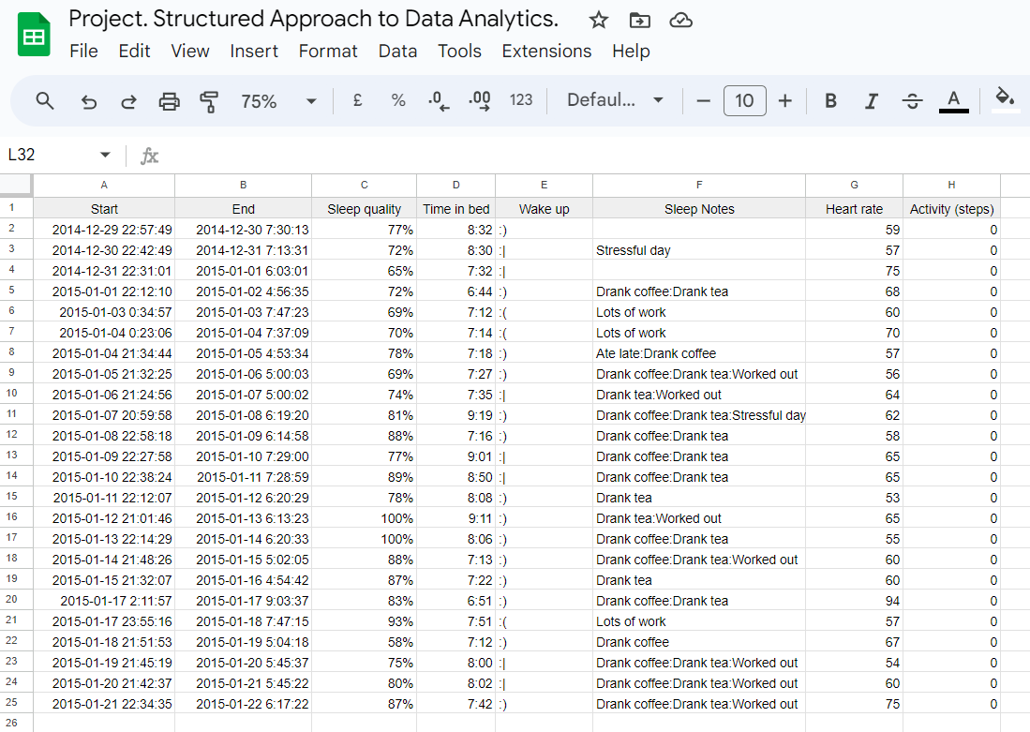
PROCESS
Raw data in Google Spreadsheets

Slide 5
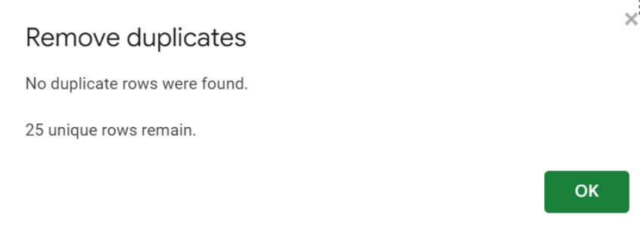
PROCESS
Data pre-processing:
Data copy/backup
Data cleaning
Duplicates
Formatting data

Slide 6
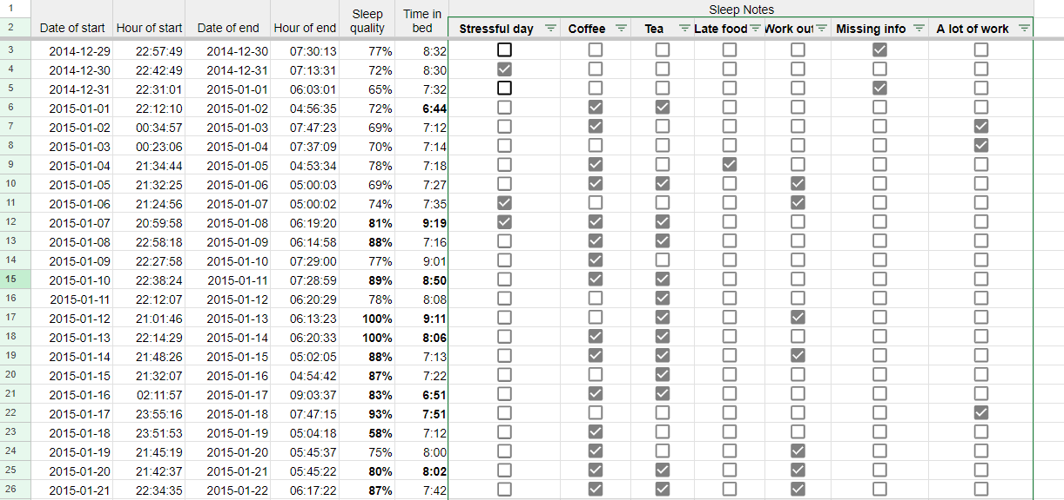
PROCESS

Slide 7
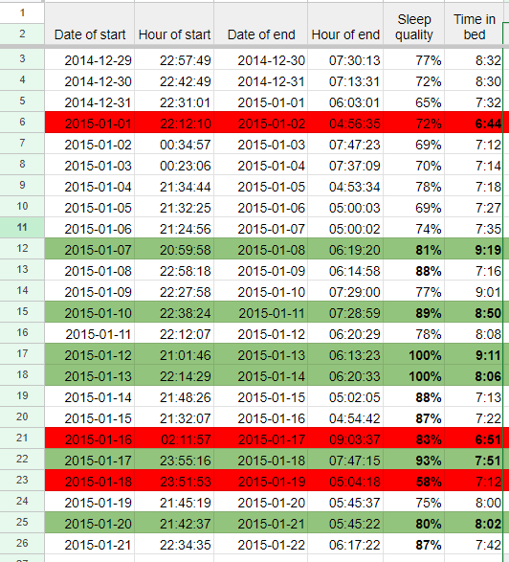
ANALYZE
How many hours does one sleep during the night?
What is the quality of sleep?
AVERAGE TIME IN BED 7:50
AVERAGE SLEEP QUALITY 80%
MINIMAL TIME IN BED 6:44
MINIMAL SLEEP QUALITY 58%
DAYS TRACKED 24

Slide 8
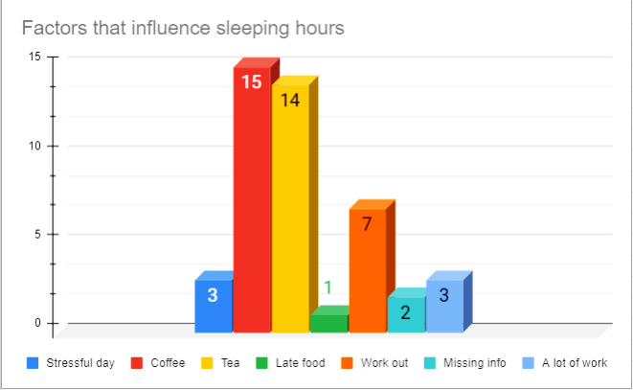
ANALYZE

Slide 9
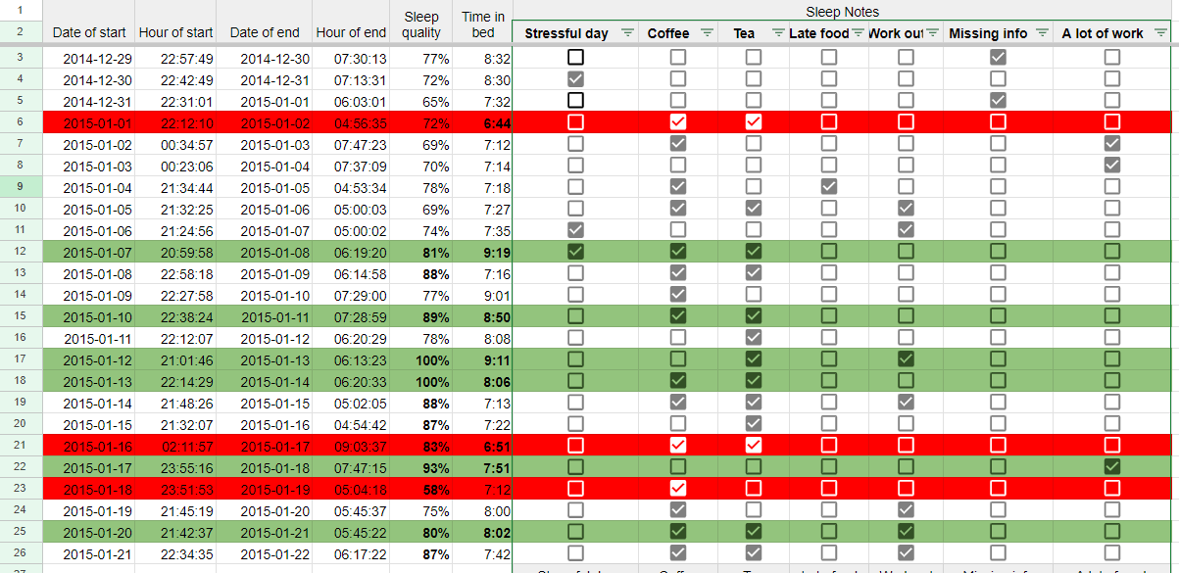
ANALYZE
HOUR OF SLEEP START 22.12h and LATER
HOUR OF SLEEP END 4.56h - 5.04h
*only once 9.03h
HOUR OF SLEEP START 20.59h - 22.38h
*only once 23.55h
HOUR OF SLEEP END 6.13 h - 7.47h
*only once 5.45h

Slide 10
Findings:
Factors of habits/situations during the day may have no influence on sleep quality/time.
WHEN one goes to sleep & wakes up - that is what makes an impact on sleep duration and quality.
Solution:
Organize one’s sleep to last on average 7-8 hours
Go to bed before 22.00h and wake up not earlier than 6.00h

